Slide 1
Functions in OOPL
CSE 213
Mousumi Hasan
Assistant Professor, CSE DEPT, BAIUST

Slide 2
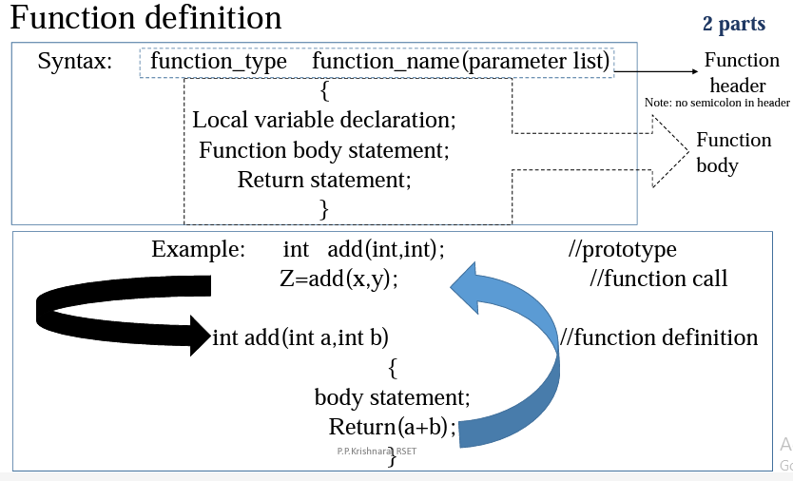

Slide 3
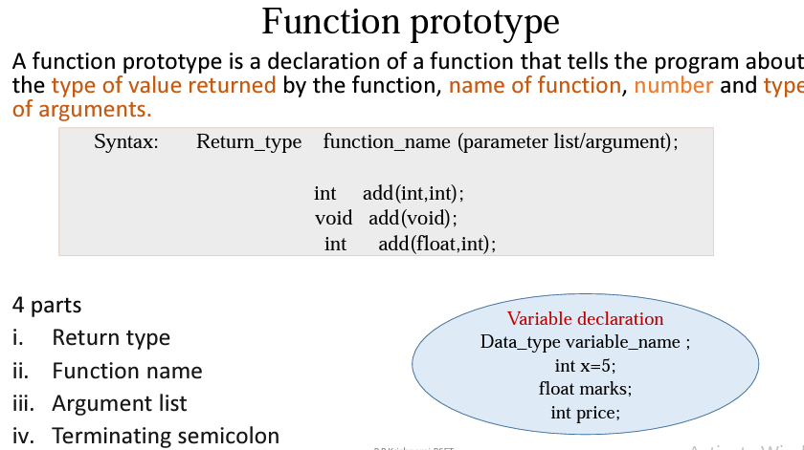

Slide 4
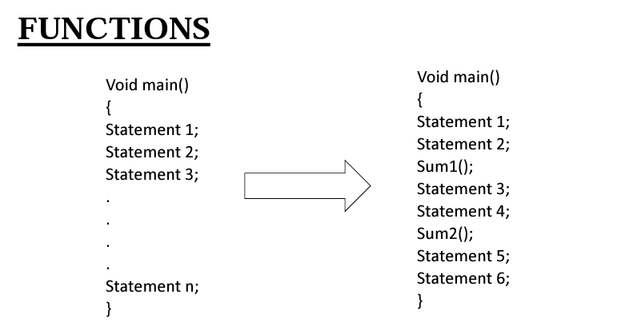

Slide 5
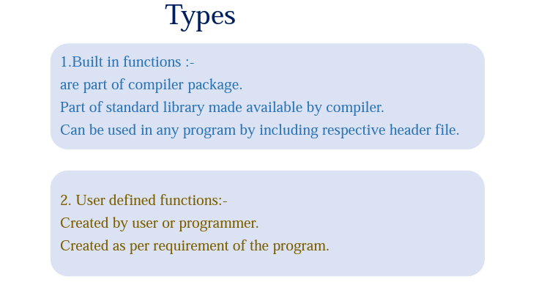

Slide 6
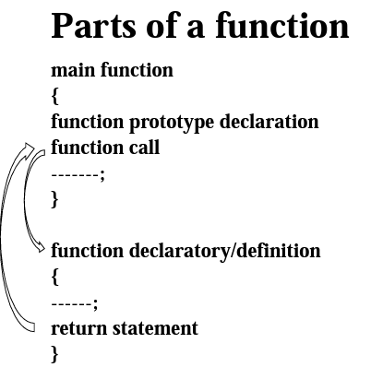
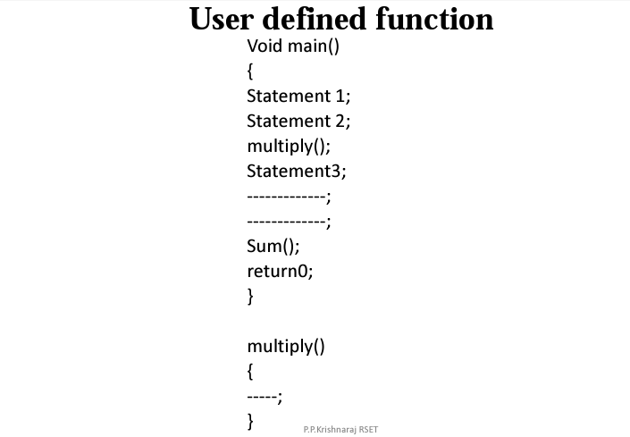

Slide 7
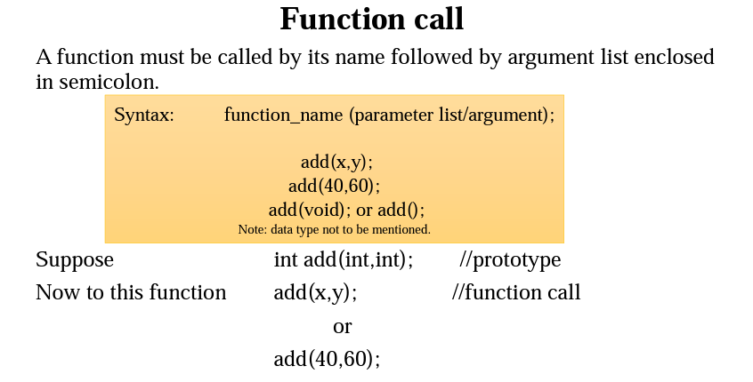

Slide 8
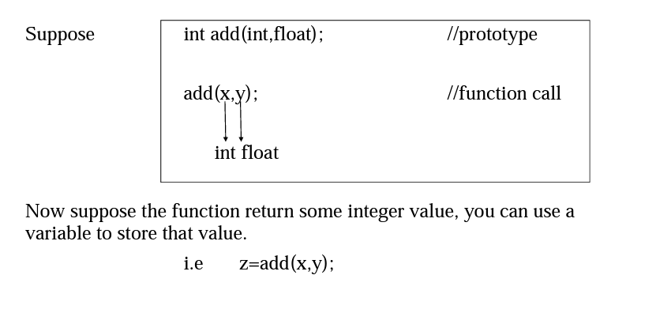

Slide 9
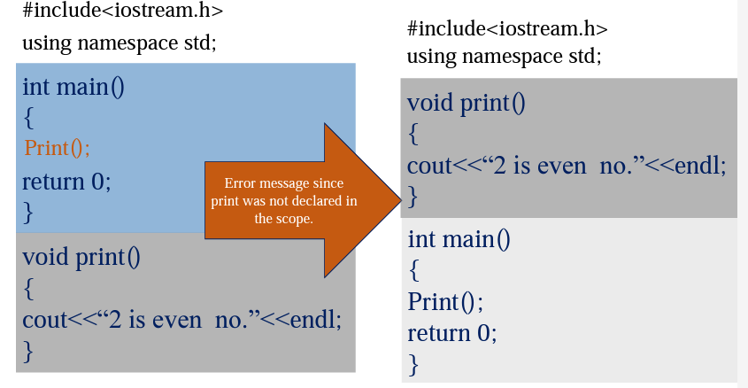

Slide 10
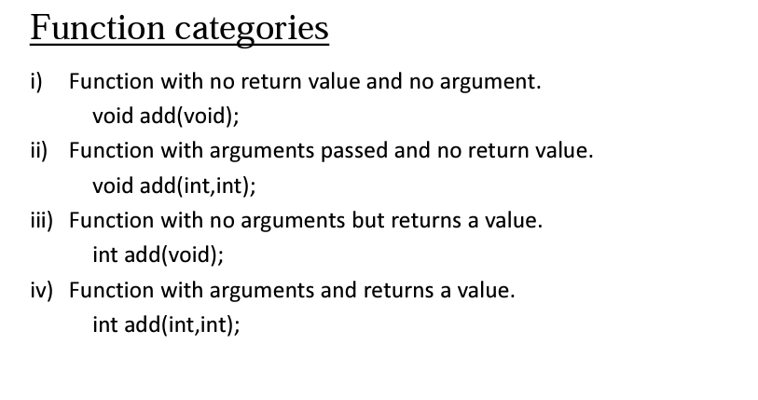

Slide 11
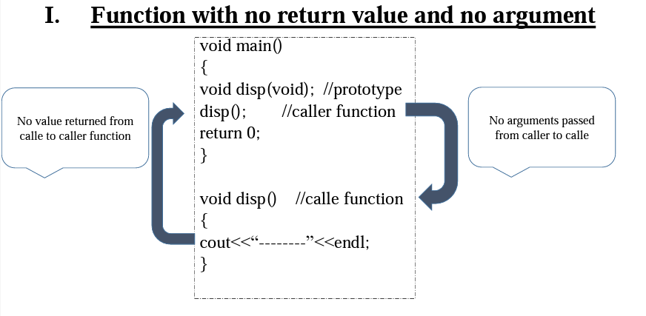

Slide 12
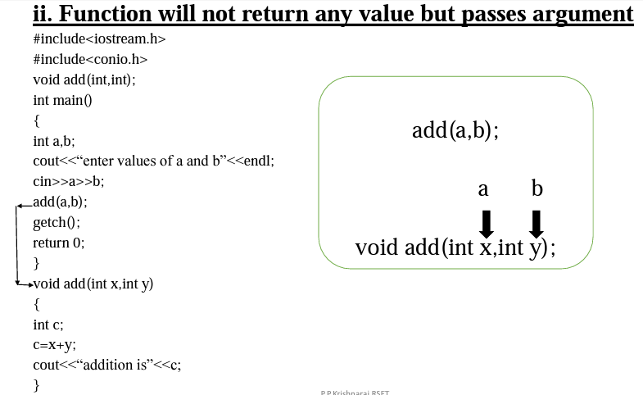

Slide 13
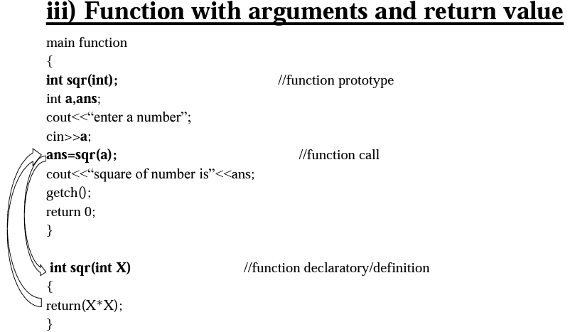

Slide 14
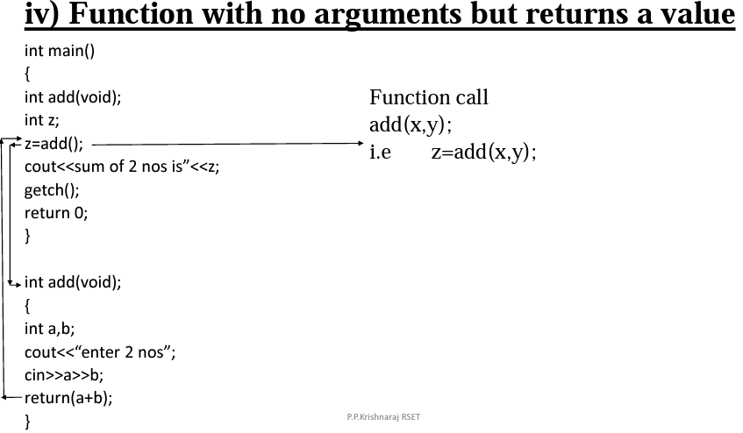

Slide 15
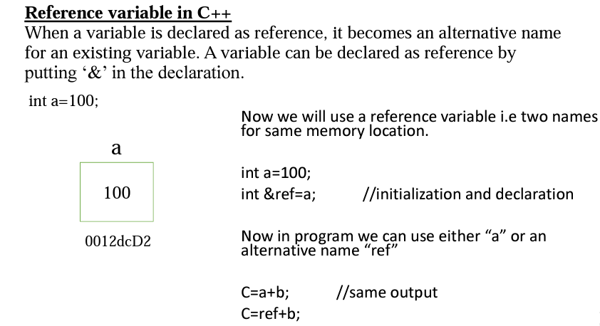

Slide 16
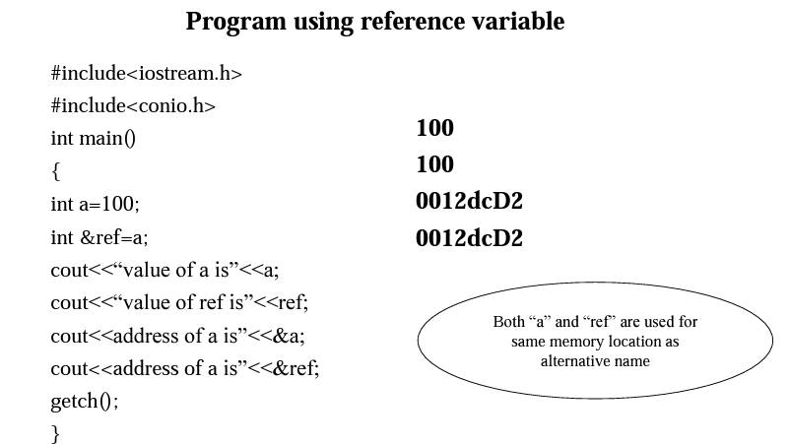

Slide 17
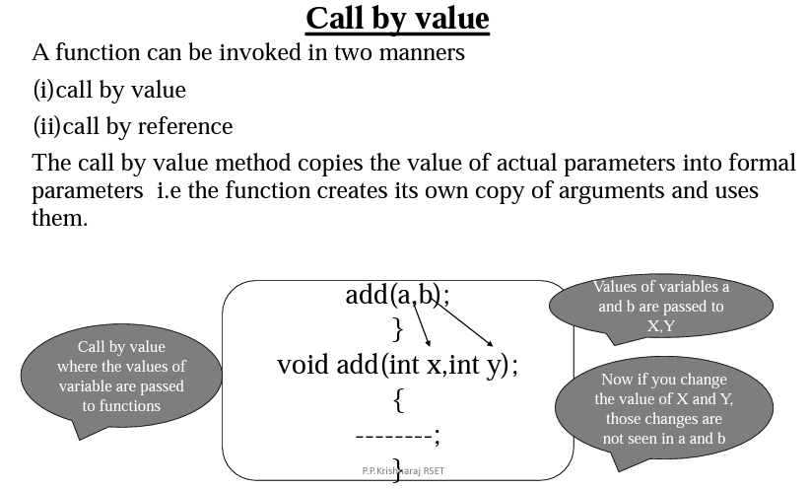

Slide 18
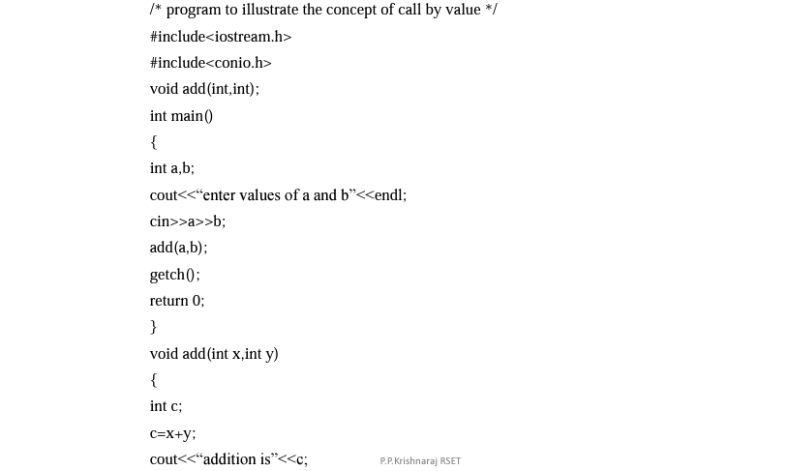

Slide 19
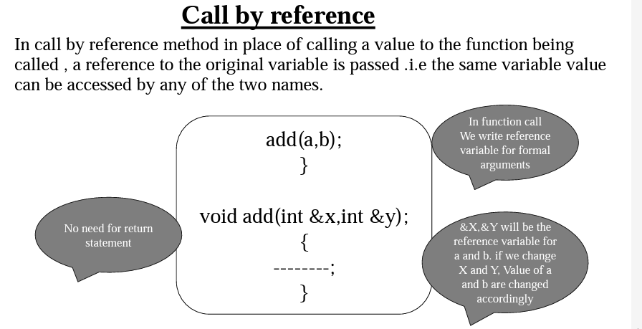

Slide 20
Call by Reference
#include<iostream>
using namespace std;
void swap(int &, int &);
int main()
{
int a,b;
cout<<" enter the values of a and b";
cin>>a>>b;
cout<<" before swaping ";
cout<<"A "<<a;
cout<<"B "<<b;
swap(a,b);
cout<< "after swaping ";
cout<<"A "<<a;
cout<<"B "<<b;
}
void swap(int &X, int &Y)
{
int temp;
temp=X;
X=Y;
Y=temp;
}

Slide 21
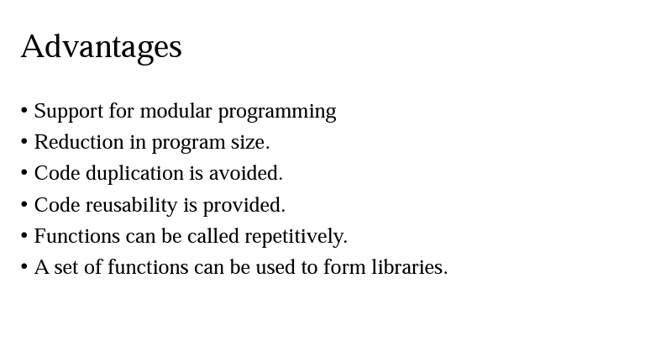

Slide 22
1. Swap Two Numbers
Write a program to swap two numbers:
(a) using call by value
(b) using call by reference
Question: Why does one version fail to swap the original values?
2. Increment Function
Create a function increment(int x):
First using call by value
Then using call by reference
Task: Observe and explain the output difference.
3. Modify Variable
Pass a variable to a function and multiply it by 5.
Check whether the original value changes (value vs reference).

Slide 23
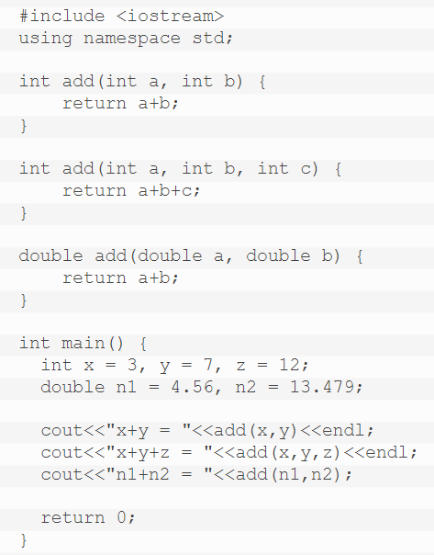
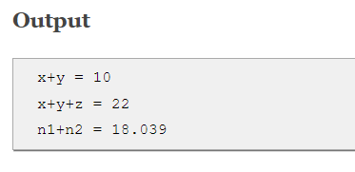
Function Overloading

Slide 24
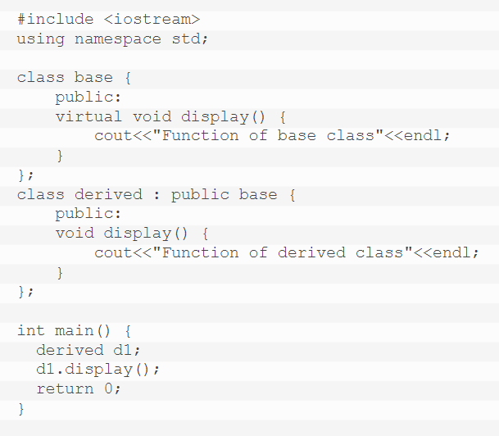

Function Overriding
Output

Slide 25
Function Overloading & Overriding
Function overloading is a concept using which we define two or more functions in the same class with the same name with a condition that the parameters of the function should differ by its number or type.
Function overriding is a concept using which we define two functions with the same name and same parameters with a condition that one function must present in a base class and other function in a derived class.

Slide 26
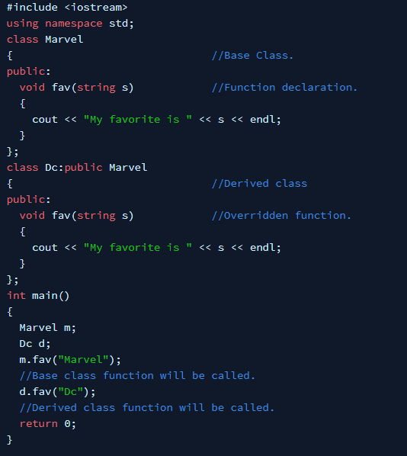

Function Overriding
Output

Slide 27
Function Overloading vs. Overriding
S.No. | Function Overloading | Function Overriding
1. | The concept through which we can define two or more functions with the same name and different numbers and parameters is known as function overloading. | The concept through which we define a function in parent class and the child class with the same return type and parameters is known as function overriding.
2. | It can take place without inheritance. | It can take place only when a class inherited from another class.
3. | It happens during compile time. | It happens during run time.
4. | It is also known as compile time polymorphism. | It is also known as run time polymorphism.
5. | The function overloading can take place multiple times. | Function overriding can take place in the derived class only at once.

Slide 28
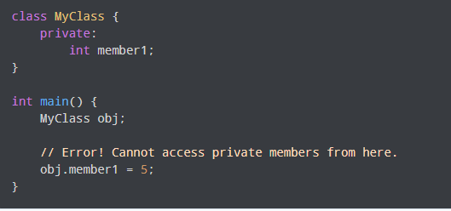
Friend function in C++
Data hiding is a fundamental concept of object-oriented programming. It restricts the access of private members from outside of the class.
Similarly, protected members can only be accessed by derived classes and are inaccessible from outside. For example,
However, there is a feature in C++ called friend functions that break this rule and allow us to access member functions from outside the class.

Slide 29
The friend function in C++ is defined outside the scope of the class. It has the authority to access all protected members and private members of the class. Friends are not member functions, but the prototypes for friend functions appear in the class function only. It covers class template, class, function template, function, and member functions, in which the entire members of the class are friends.

Slide 30
Friend function in C++
A friend function in C++ is defined as a function that can access private, protected and public members of a class.
The friend function is declared using the friend keyword inside the body of the class.
By using the keyword, the ‘friend’ compiler understands that the given function is a friend function.
Friend Function Syntax:
class className {
... .. ...
friend returnType functionName(arguments);
... .. ...
}

Slide 31
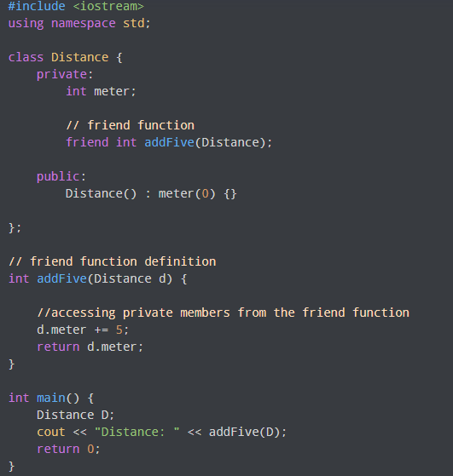
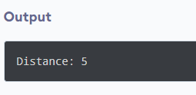
Friend function in C++
Here, addFive() is a friend function that can access both private and public data members.

Slide 32
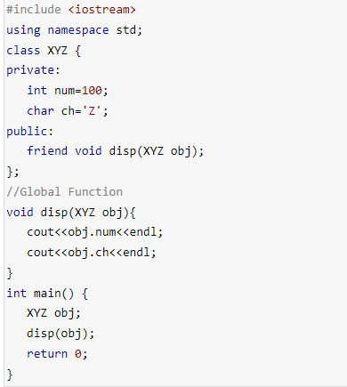
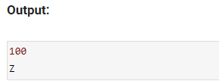
Friend function in C++

Slide 33
Thank You!!

